Slide 1



Banking:
Customer Exit Insights
Akshata Botre & Maryam Adebayo

Slide 2
Table of contents
01
02
03
04
Storyboard
Data & Transformations
Dashboard
Story

Slide 3

01
Data & Transformations
Dataset Link: https://www.kaggle.com/datasets/gauravtopre/bank-customer-churn-dataset

Slide 4
Transformed Columns
HasCrCard
Exited
IsActiveMember
Converted:
1 -> Yes
0 -> No
Converted:
1 -> Yes
0 -> No
Converted:
1 -> Yes
0 -> No

Slide 5
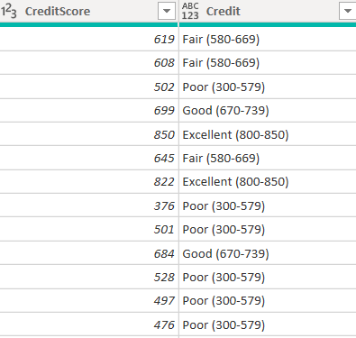
Conditional Column
Credit Score
Created a new column, “Credit”, binning credit scores into categories:
Poor,
Fair,
Good,
Very Good,
and Excellent.

Slide 6

02
Storyboard

Slide 7
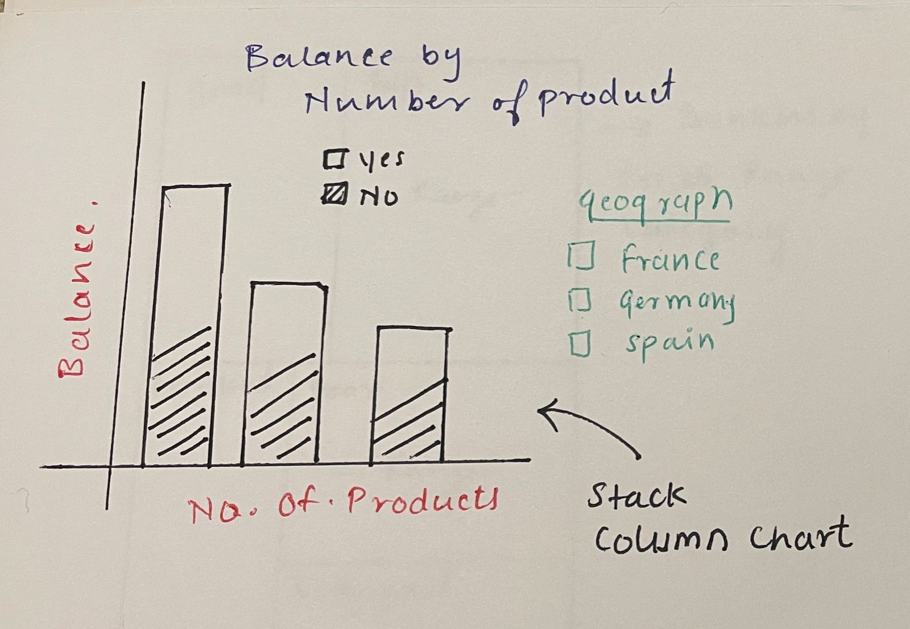
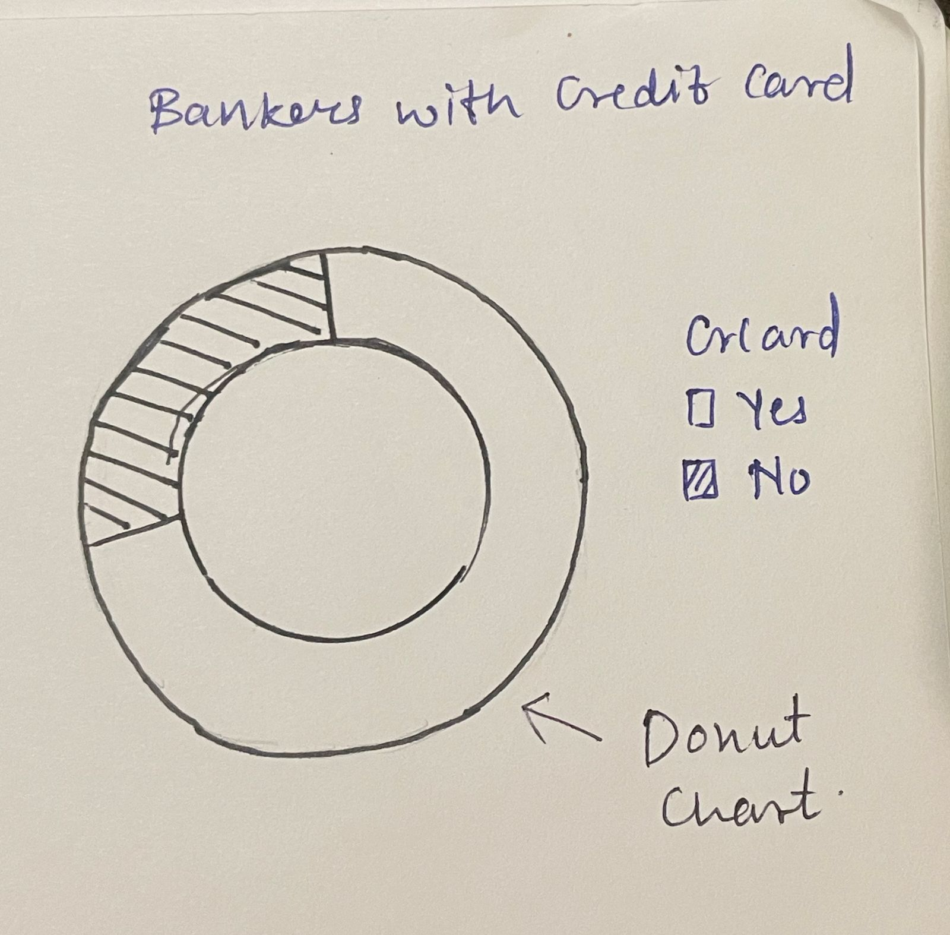
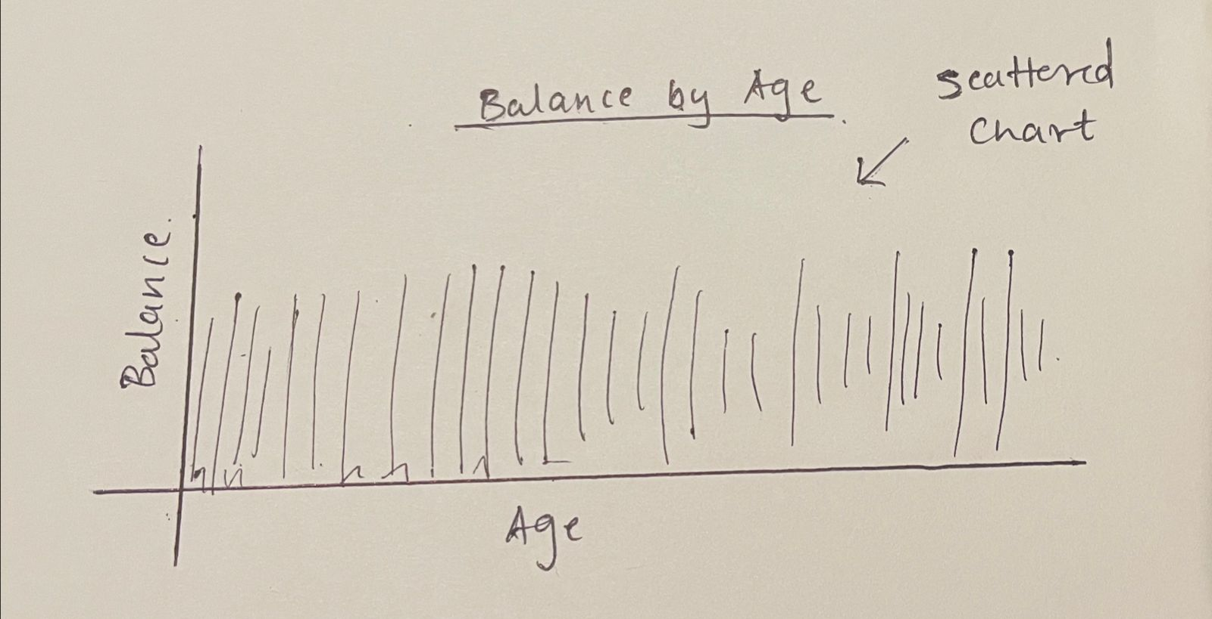
Initial Sketch
This sketch represents a stacked column chart showing customer balances by the number of products held. Each bar splits into "Exited" (Yes) and "Not Exited" (No) segments, allowing easy comparison of balances between these groups.
The geographic filter on the left enables users to view data specific to France, Germany, or Spain, providing regional insights. This chart helps reveal if holding multiple products correlates with higher balances or retention.
This sketch illustrates a donut chart representing the proportion of bankers who have a credit card ("Yes") versus those who do not ("No"). This visualization provides a quick snapshot of credit card ownership among customers, helping identify the percentage of customers engaged with this product.
This sketch presents a scatter chart displaying customer balances across different ages. The visualization helps identify balance trends by age group, revealing patterns such as potential peaks in balance at specific ages, which can guide targeted financial strategies. By examining balance distribution by age, this chart aids in understanding which age groups hold higher balances, supporting age-based segmentation for customer outreach and retention efforts.

Slide 8
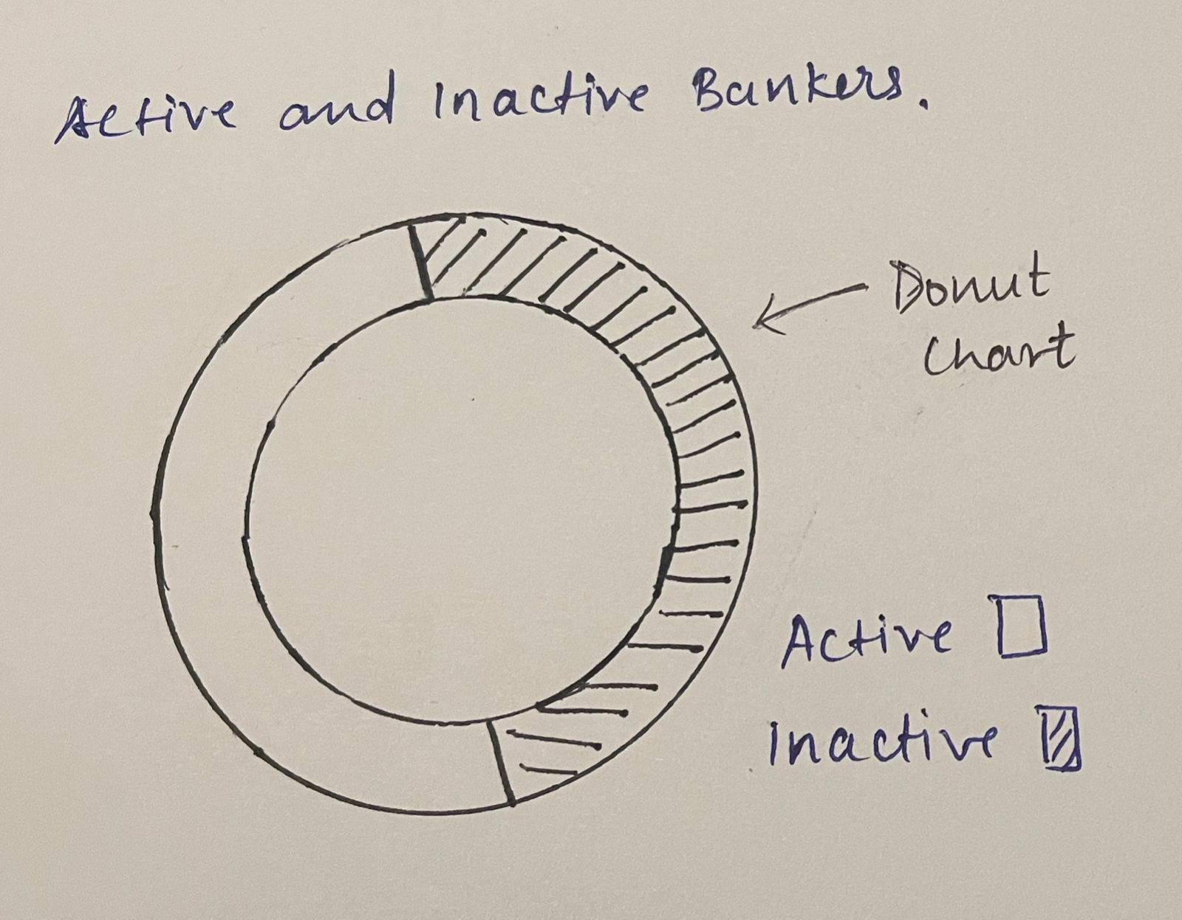
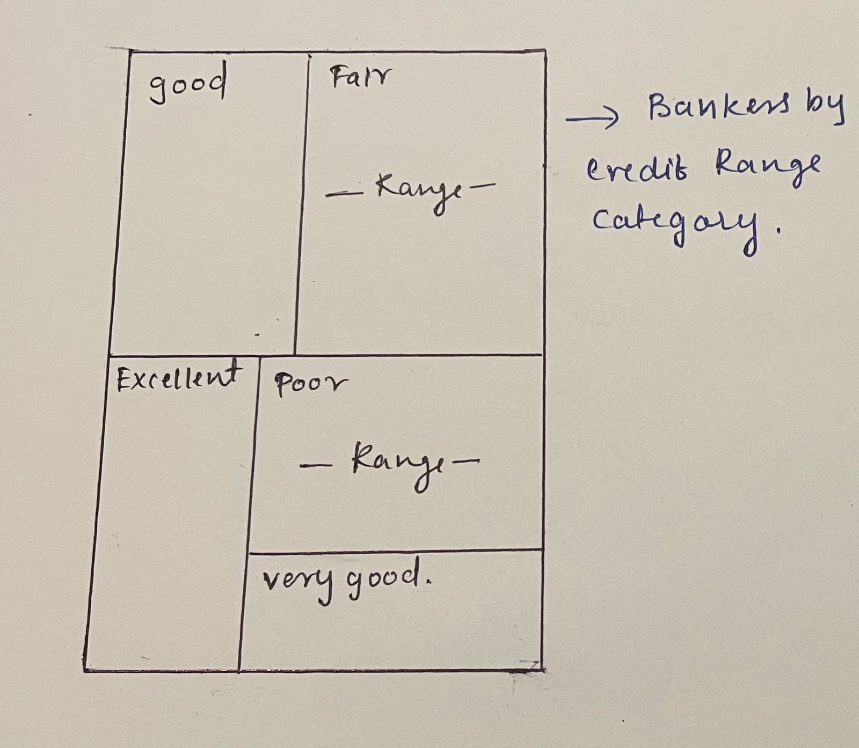
Initial Sketch
This sketch displays a treemap chart categorizing bankers by their credit score ranges: Poor, Fair, Good, Very Good, and Excellent. Each segment represents a different credit range, with the size of each box indicating the proportion of customers within that category. This visualization helps identify the distribution of credit scores across the customer base, supporting strategies for tailored financial products or targeted marketing for specific credit segments.
This sketch shows a donut chart visualizing the proportion of active versus inactive bankers. Each section represents the share of customers who are currently active compared to those who are inactive. This chart quickly highlights the level of customer engagement, helping to identify the retention rate and the inactive segment that may benefit from re-engagement strategies.

Slide 9
Storyboard
Banker Distribution by Geography This section sets the stage by giving a geographic breakdown of customers in France, Germany, and Spain. It identifies key markets with high customer counts, specifically Germany and France, where the bank can focus its engagement efforts. By understanding the distribution across regions, stakeholders gain an initial sense of where their core customer base resides, laying the foundation for deeper insights into these regions.
Balance by Number of Products Next, the dashboard delves into customer behavior by examining the balance held by customers relative to the number of products they own. This view is segmented by exit status (Exited vs. Not Exited), highlighting whether product adoption correlates with retention and higher balance levels. For instance, if customers with more products tend to have higher balances and lower exit rates, it suggests that cross-selling additional products could be an effective retention strategy.
Bankers with Credit Card This donut chart gives a quick snapshot of credit card ownership among customers, showing the proportion of those with and without a card. This insight helps the bank assess the reach of one of its key financial products and consider marketing strategies to encourage credit card adoption among customers who currently don’t have one. Understanding this distribution is valuable for planning product-specific campaigns and boosting customer engagement.

Slide 10
Storyboard
Balance by Age
In this section, the dashboard shifts to a demographic analysis, using a scatter plot to show customer balances across various age groups. This view helps identify which age demographics hold higher balances, signaling where the bank may focus its premium services or retention efforts. For instance, if middle-aged customers hold higher balances, the bank might develop targeted loyalty programs to secure this valuable segment.
Active and Inactive Bankers This donut chart provides an overview of customer engagement by showing the ratio of active to inactive bankers. Identifying the inactive segment allows the bank to assess the potential for re-engagement initiatives. This insight is critical for understanding engagement levels, allowing stakeholders to prioritize efforts to re-engage inactive customers and improve the overall retention rate.
Bankers by Credit Range Category This treemap categorizes customers based on their credit scores, with segments for Poor, Fair, Good, Very Good, and Excellent credit ranges. Each box’s size represents the share of customers within that credit range, providing a quick overview of the customer base’s credit profile. The chart supports a drill-through feature: by drilling through on a specific credit category (e.g., "Good" or "Excellent"), users can access detailed information about individual customers within that range, such as Customer ID, Name, and Balance. This additional layer of detail helps the bank assess credit-specific engagement and target high- or low-credit customers with tailored financial products or support services.

Slide 11

03
Dashboard

Slide 12
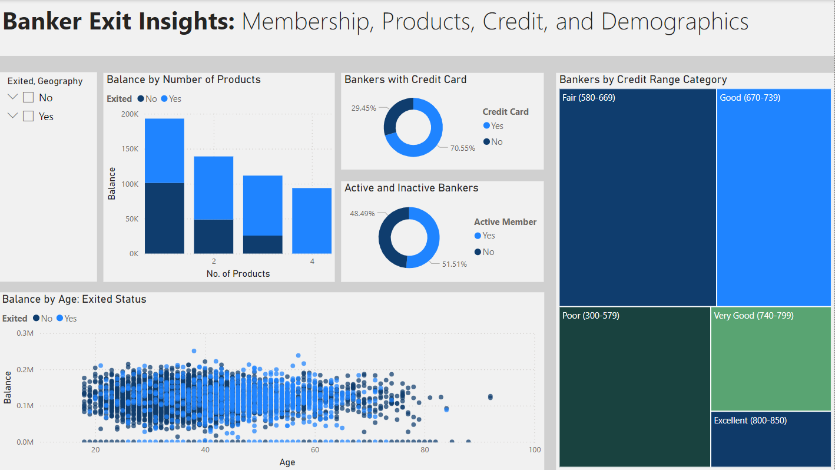

Slide 13
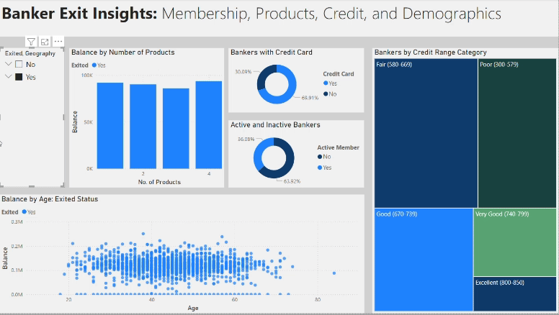
Filters

Slide 14
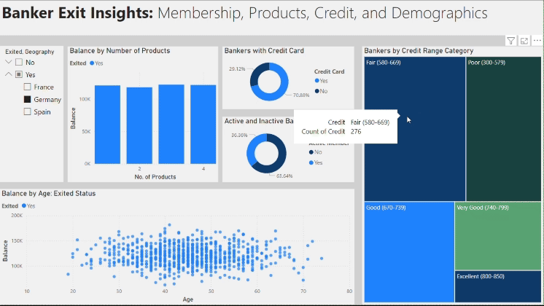
Drill Through

Slide 15

04
Story

Slide 16
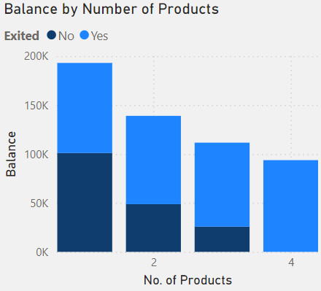

In France , Germany and Spain…
Bankers who purchased more products were more likely to exit.

Slide 17
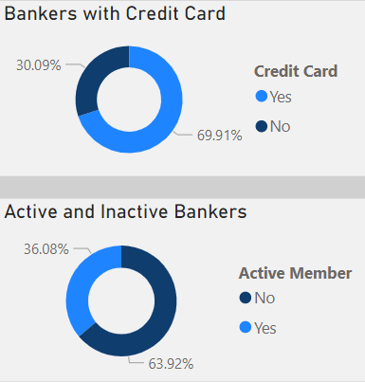
In France , Germany and Spain…
Although most bankers were credit card holders, exiting bankers were generally not active members of the bank.

Slide 18
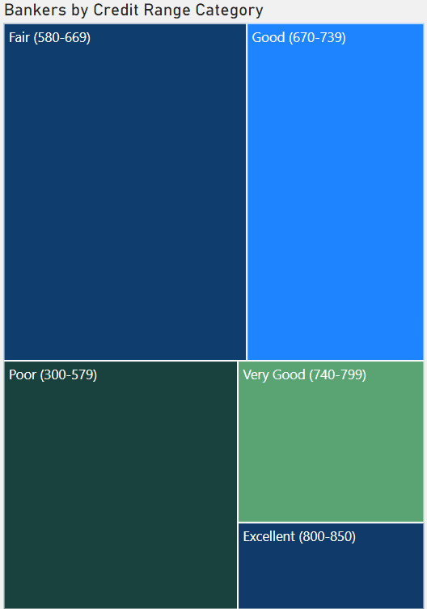
In France , Germany and Spain…
Both exiting and non-exiting bankers had credit scores between 300 and 739, classified as Poor, Fair, or Good.

Slide 19
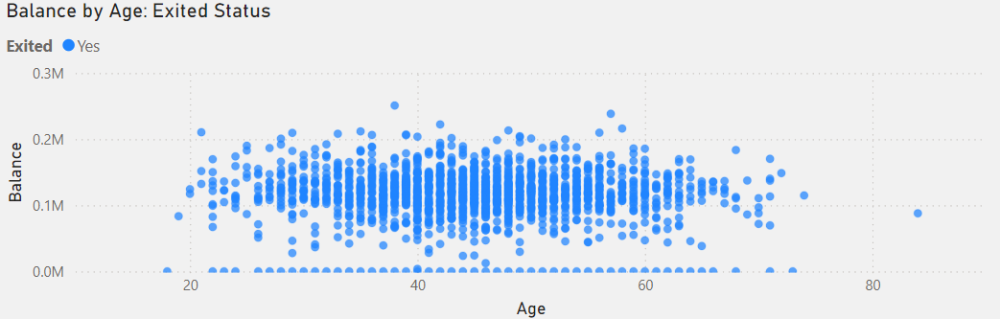
Age v Balance: Exiting Bankers
Age Range: ~30 - 60
Balance: ~$50K-200K

Slide 20
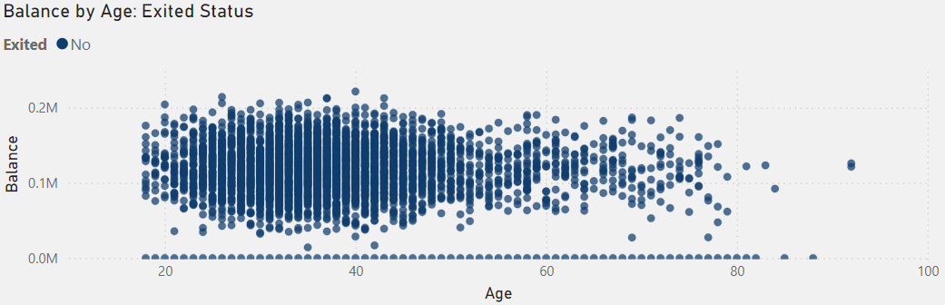
Age v Balance: Non-exiting Bankers
Age Range: ~18 - 50
Balance: ~$50K-200K

Slide 21
Recommendations…
Encourage bankers to limit purchases to no more than 2 products.
Develop strategies to promote increased engagement with bankers.

Slide 22

Thank you!

